Slide 1
Module I Speaking
Public speaking: Voice and Language

Slide 2
Key points – Language
Accurate spoken grammar
Appropriate vocabulary and tone
Avoids filler words and sounds, slang, profanity, stuttering, staccato repeaters
Uses transitions and signposts

Slide 3
Key points – Voice
Pronunciation
Speaking speed
Volume
Intonation and pitch
Pauses

Slide 4
Grammatical Accuracy
Proper usage of grammar is important because it allows us to have our messages clearly understood and establishes credibility in a speech.
However, remember to strike a balance between ‘grammar accuracy’ and ‘fluency.’
Grammar Accuracy
Fluency

Slide 5
Vocabulary
Avoid slang in formal speeches like career speeches, academic speeches, and professional speeches.
Avoid Big Words (unless you need to impress people at an academic conference).
Avoid using too much technical jargon and try to use plain English instead. If necessary, explain terms when you first use them.
Avoid profane language in your speech.

Slide 6

Avoid staccato repeaters, filler words, and stuttering.
Staccato repeaters are vocalized expressions like “uh-uh-uh.”
Filler words include like, you know, maybe, I think…

Slide 7

Tips to avoid filler words
Get comfortable with silence.
A good pause can speak volumes. There are even times when it’s appropriate to stop altogether.
Be aware of filler words.
Practice a little bit louder than you normally would so the fillers stand out more.
Take a nice breath.
It gives a nice pause to your listeners and also helps you relax.

Slide 8

Transitions and signposts
What are speech transitions?
Different types of transitions
Common mistakes in using speech transitions

Slide 9
What are speech transitions?
Speech transitions are words and phrases that allow you to smoothly move from one point to another so that your audience is able to understand your argument.
Speech transitions are useful for unifying and connecting your presentation. They show how one point relates to another.
It's important to practice your transitions beforehand and not just the content of your arguments because you risk looking unprofessional and confusing the audience if the presentation does not flow smoothly.

Slide 10
Types of transitions
Introduction
Moving from the introduction to the first point
Shifting between similar points
Shift between disagreeing points
Transition to a significant issue
Referring to previous points
Internal summaries
Cause and effect
Elaboration
Introduce an example
Transition to a demonstration
Transition to a visual aid
Conclusion
https://virtualspeech.com/blog/how-to-structure-your-presentation

Slide 11
Introduction
Introduce your topic:
We will be looking at/identifying/investigating the effects of...
Today I will be discussing...
Inform the audience of the structure of your presentation:
There are three key points I'll be discussing...
I want to begin by..., and then I'll move on to...
We'll be covering... from two points of view...
This presentation is divided into four parts...

Slide 12
Move from the introduction to the first point
Signify to the audience that you will now begin discussing the first main point:
Now that you're aware of the overview, let's begin with...
First, let's begin with...
I will first cover...
My first point covers...
To get started, let's look at...

Slide 13
Shift between similar points
Move from one point to a similar one:
In the same way...
Likewise...
Equally...
This is similar to...
Similarly...

Slide 14
Shift between disagreeing points
Introduce conflicting ideas:
Conversely...
Despite this...
However...
On the contrary...
Now let's consider...
Even so...
Nonetheless...
We can't ignore...
On the other hand...

Slide 15
Transition to a significant issue
Emphasize importance:
Fundamentally...
Primarily...
A major issue is...
The crux of the matter...
A significant concern is...
More importantly...
This is essential...

Slide 16
Referring to previous points
Refer to something that you've already spoken about:
Let’s return to...
We briefly spoke about X earlier; let's look at it in more depth now...
Let’s revisit...
Let’s go back to...
Do you recall when I mentioned...

Slide 17
Internal summaries
Internal summarising consists of summarising before moving on to the next point. You must inform the audience:
What part of the presentation you covered – In the first part of this speech we've covered...
What the key points were – The most important information is…
How this links in with the overall presentation – So that's the context...
What you're moving on to – Now I'd like to move on to the second part of presentation which looks at...

Slide 18
Cause and effect
Show relationships between factors:
Therefore...
Thus...
Consequently...
As a result...
This is significant because...
Hence...

Slide 19
Elaboration
Also...
Besides...
What's more...
In addition/additionally...
Moreover...
Furthermore...

Slide 20
Introduce an example
This is demonstrated by...
For instance...
Take the case of...
For example...
You may be asking whether this happens in X? The answer is yes...
To show/illustrate/highlight this...
Let me illustrate this by...

Slide 21
Transition to a demonstration
Now that we've covered the theory, let's practically apply it...
I'll conduct an experiment to show you this in action...
Let me demonstrate this...
I'll now show you this..

Slide 22
Transition to a visual aid
Before you show the visual aid, explain why you're going to show it:
This graph is a significant piece of evidence supporting X.
When the graphic is on display, explain what the visual is showing and get the audience to focus on it:
The table indicates... As you can see...
I'd like to direct your attention to...
You can see that there has been a reduction in...
The diagram is comparing the...

Slide 23
Conclusion
1. Signal that it's nearly the end of your presentation
As we wrap up/as we wind down the talk…/Finally, I want to say...
2. Restate the topic and purpose of your presentation
In this speech I wanted to compare…
3. Summarise the main points, including their implications and conclusions
Let's recap on what we've spoken about today...
Let me briefly summarize the main points...
4. Indicate what is next/a call to action/a thought-provoking takeaway
I'd like to leave you with this...
What you should take away from this is...

Slide 24
Common mistakes
Using transitions that are too short - transitions are a key part of ensuring the audience understands your presentation so spend sufficient time linking to your next idea.
Too many tangents - Any digressions should still be relevant to the topic and help the audience with their understanding, otherwise cut them out.
Incompatible transitions - Use transitions that signify the relationship between points.
Over-using the same transition - This is boring for the audience to hear repeatedly. Ensure that there is variety with your transitions, consider including visual transitions.

Slide 25
References
https://open.lib.umn.edu/publicspeaking/chapter/13-2-using-language-effectively/
https://www.youtube.com/watch?v=hUY8DiQgUUg (How to avoid fillers)
https://virtualspeech.com/blog/speech-transitions-words-phrases
https://virtualspeech.com/blog/different-ways-to-end-presentation-speech

Slide 26
Voice: pronunciation
When it comes English speaking, the most important thing isn’t to sound British or American but to have good and clear pronunciation. Only by using the correct sounds when you speak can others understand what you’re saying.

Slide 27
Voice: pronunciation
To have good and clear pronunciation, it is a must that you learn…
International
Phonetic
Alphabet

Slide 28

Voice: pronunciation

Slide 29
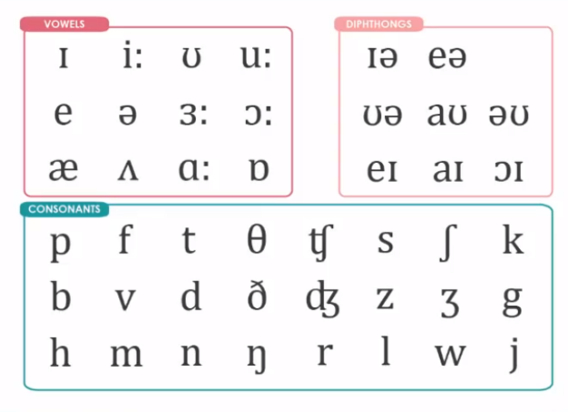
Voice: pronunciation
Now you may review the sounds with your instructor

Slide 30
Voice: pronunciation
Activity: Pronounce the following words according to their IPAs.
Mischievous /ˈmɪs tʃə vəs/
Salmon /ˈsæ mən/
Subtle /ˈsʌ tl/
Psychiatry /saɪˈkaɪ ə tri:/
Genuine /ˈdʒɛ nyuin/
Technology /tɛkˈnɒ lə dʒi:/
Circumstance /ˈsɜ: kəmˌstəns/
Archaeological /ˌɑ: kiəˈlɒ dʒɪ kəl /
Familiarity /fəˌmɪli:ˈæ rɪ ti:/
Although /ɔ:lˈðəʊ/
Throughout /θruːˈaʊt/
Velvet /ˈvelvɪt/
Freestyle /ˈfriːstaɪl/
Champagne /ˌʃæmˈpeɪn/
Entrepreneur /ˌɒntrəprəˈnɜː(r)/

Slide 31
Voice: pronunciation
Other possibly useful videos and words to help you with easily mispronounced sounds
/v/ and /f/ sounds: https://www.youtube.com/watch?v=nR-K3mrHFv0
(velvet; however; variation; vroom vroom)
/el/ and /eɪl/ sounds: https://www.youtube.com/watch?v=SqN3kGMLwio
(sale; sailing; frail)
/l/ sound: https://www.youtube.com/watch?v=pejo6YC_BnM
(style; pencil; pool; cool)
/tr/ and /dr/ sounds: https://www.youtube.com/watch?v=DNHI1biK0-4
(try; trench; true; trap; tradition; drive; drown)
Th sound: https://www.youtube.com/watch?v=nlKNo1TGALA
(“I think that you should think through thoroughly to test the theory”)
/s/ and /z/ sounds: https://www.youtube.com/watch?v=xl-7mSeybmI
(clothes; pizzazz; buzz; use; Tuesday)

Slide 32
Voice: speaking speed
The speed at which you talk has a huge influence on how the audience perceives you and your speech. Speaking rate is often expressed in words per minute (wpm).
Speaking rate (wpm) = total words / number of minutes
The average speaking speed changes for the purpose of your speech. For presentations, usually, it’s between 100-150 wpm. For conversations, it’s between 120-150 wpm.

Slide 33
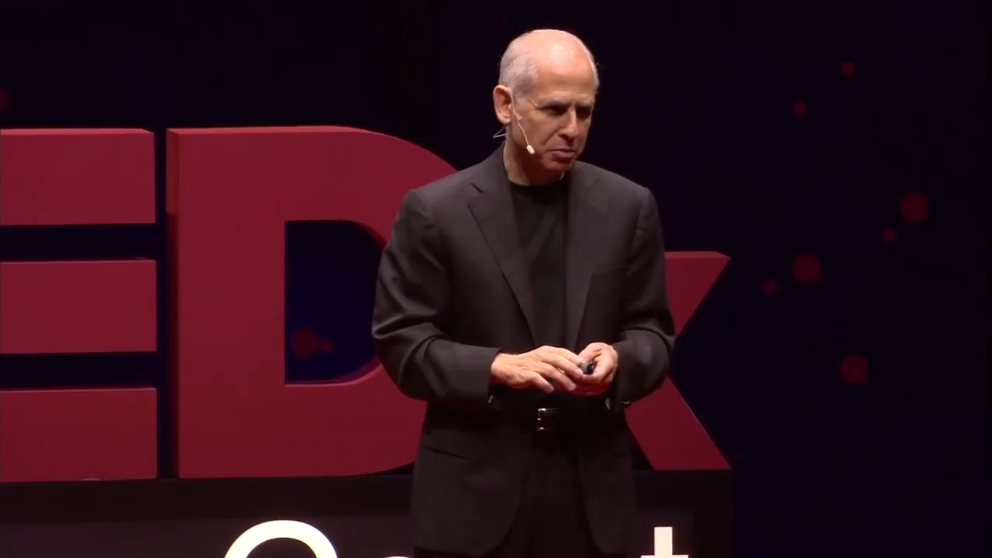
Voice: speaking speed
Here’s how 120 wpm sounds

Slide 34
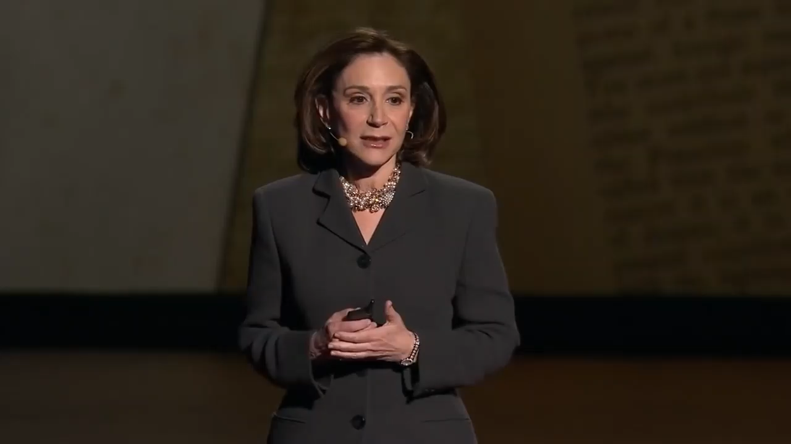
Voice: speaking speed
Here’s how 140 wpm sounds

Slide 35
Voice: speaking speed
Activity: The paragraph below is 122 words. You should finish reading it out loud in one minute (or slightly longer). Practice this and remember this speed for your future presentations.
“Speaking speed is indeed very important. Your rate of speech does have an impact on how the audience perceives you and your message. Generally, a slower rate is easier to understand for the audience. If you include pauses as well, you give the audience time to absorb the messages of your presentation. No matter what your average speaking rate is over the entire speech, you should vary it throughout the speech. Varying your speech makes it more interesting for the audience and adds emotion to the content. Without pace variation, you’re in danger of sounding monotone. For example, you can speak faster to convey excitement or to suggest that this part is not that important, or slower to reflect sincerity or importance.”

Slide 36
Voice: speaking speed
Activity: Now read this paragraph again and understand it. Decide which sentences or parts you think should be read slower and practice.
“Speaking speed is indeed very important. Your rate of speech does have an impact on how the audience perceives you and your message. Generally, a slower rate is easier to understand for the audience. If you include pauses as well, you give the audience time to absorb the messages of your presentation. No matter what your average speaking rate is over the entire speech, you should vary it throughout the speech. Varying your speech makes it more interesting for the audience and adds emotion to the content. Without pace variation, you’re in danger of sounding monotone. For example, you can speak faster to convey excitement or to suggest that this part is not that important, or slower to reflect sincerity or importance.”

Slide 37
Voice: speaking speed
When to change your speed:
Fast: indication of passion, urgency, excitement, and emotion; delivery of a story
Slow: indication of importance, sadness, confusion, the seriousness of a point or the introduction of new ideas (use to help the audience grasp what you are saying)

Slide 38
Voice: volume
Volume is the loudness of the speaker. The appropriate volume should allow the farthest listener to hear you clearly, and at the same time not annoy the nearest listener.
Some tips:
When you speak, face the audience. Do NOT face the whiteboard, the floor, the ceiling or the door. Sound travels in straight line.
Standing straight could surprisingly increase your volume.
Practice speaking by thinking of people at different distances to you such as at your elbow, across the room, or in the back of a large hall.

Slide 39
Voice: varying your volume
The increase in volume makes it clear which words are the most important in the sentence. If you remember the speaking rate part, slowing down also has the same effect. The words might include:
Words you want to emphasize
Content words (as opposed to function words)
“When you speak, face the audience. Do not face the whiteboard, the floor, the ceiling or the door.”
“Generally, a slower rate is easier to understand for the audience.”
You don’t have to follow this exactly. But do keep in mind that you need to raise your voice for more important parts.

Slide 40
Voice: intonation and pitch
Pitch is the degree of highness or lowness of a tone or voice while intonation is the variation of pitch in the spoken language.

Slide 41
Voice: intonation and pitch
Activity: Read the sentences below out loud. The underline indicates a higher pitch. Try to think how different intonations imply different meanings.
I like cookies. I like cookies.
We don’t have time. We don’t have time.
She didn’t steal my wallet.
She didn’t steal my wallet.
She didn’t steal my wallet.
She didn’t steal my wallet.
She didn’t steal my wallet.

Slide 42
Voice: intonation and pitch
A change in pitch is usually used to emphasize. If you recall what we’ve learnt in speaking speed and volume, a change in speed or volume also does the trick. In reality, when we want to “point out” to the audience which part is important in our speech, we usually use the combination of all three. When you do your presentation, if you fail to vary your speed, volume or pitch to suit your purposes, you will sound boring and consequently receive a lower score for this part.

Slide 43
Voice: intonation and pitch
Pitch glide
Glide up (rising intonation): questions, uncertainties, etc.
Glide down (falling intonation): statements, authority, etc.
When reading a long sentence, a rising intonation (or a high pitch) indicates that the sentence is not yet finished. A falling intonation signals the end of a sentence.
Activity: Use the sentences below to practice pitch and pitch glide. The arrows indicate rising or falling intonations. The underlines indicate higher pitch.
“Your rate of speech does have an impact↑ on how the audience perceives you↑ and your message↓.”
“For example↑, you can speak faster to convey excitement or to suggest that this part is not that important, or slower to reflect sincerity or importance↓.”

Slide 44
Voice: pause
To pause…in a speech seems counter-intuitive (/ɪnˈtjuːətɪv/). But well-used pauses could bring your speech to another level. It could
Give your audience time to process what you’ve just said
Help you reduce fillers
Make you look confident and in control

Slide 45
Voice: pause
There are in general two types of pauses:
Grammatical pauses
These pauses in speech are like punctuations in writing
Dramatic pauses
These pauses are for certain speech styles or effects
1. The pause before your speech: before you start your speech, take the stage, look at your audience and smile.
“Stand, stare, and command your audience, and they will bend their ears to listen” (James Humes)

Slide 46
Voice: pause
Dramatic pauses
These pauses are for certain speech styles or effects
2. The pause indicating that something important is coming: the audience is being guided to expect what comes next.
It’s usually used with signposts: “Now let me tell you this (pause). The real difficulty isn’t…”
3. The pause to give the audience time to think
It’s usually used after showing statistics, explaining concepts or telling a story

Slide 47
Voice: pause
Dramatic pauses
These pauses are for certain speech styles or effects
4. The pause when moving to a new topic: this is to tell the audience that the coming part is different from the previous one.
5. The pause for emphasis: for shocking ideas, statistics or facts, you may pause to strengthen the shocking effect.
“If anything kills over 10 million people in the next few decades, it’s most likely to be a highly infectious virus rather than a war. Not (pause) missiles, but microbes” (“The next outbreak? We’re not ready”, Bill Gates).

Slide 48
Voice: pause
Dramatic pauses
These pauses are for certain speech styles or effects
6. sentence-completion pause: you pause before the end of sentence that you know your audience can finish it for you. This boosts your confidence, engages your audience and makes your speech more interactive.
“But we shouldn’t be too scared of this because where there’s a will, there is a—” (pause and wait for the audience to fill in)
Caution:
You may use hand gestures and body languages to encourage or invite the audience to fill in.
This technique is tricky. It is only recommended for more experienced students.
No matter the audience fills in or not, always remember to repeat the part by yourself (“yes, there is a way”).

Slide 49
Voice
Conclusion:
To deliver a good speech, you need to have accurate and clear pronunciation to simply be understood. Other than this, your speaking speed and volume needs to be appropriate. You also need to vary your speed, volume and pitch to signal different attitudes and to stress what’s really important. Finally, dare to pause.

